Slide 1
Provider Training 2025
Model of Care (MOC)
PROV_2025_28_E

Slide 2
CMS Requirement
As stipulated by the regulatory agency the Centers for Medicare and Medicaid Services (CMS), all employees, providers and delegated entities must be trained in the elements of the Model Of Care at the time of hiring/contracting and then annually.

Slide 3
At the end of this lesson on the Introduction to the Model of Care, you will learn to:
Describe the Special Needs Plans (SNPs) and the population served by the MOC Chronic Condition Special Needs Plans (C-SNP) and Dual Eligible Special Needs Plans (D-SNP).
Define and recognize the four elements of the MOC.
Recognize essential components in MOC care coordination.

Slide 4
Definitions
CAHPS: (Consumer Assessment of Health Providers and Systems): Survey that collects, evaluates and reports on the experience (perception) of members in relation to services received from the insurer and providers.
CM (Care Management): Care Management Program / Care Manager.
HEDIS: Healthcare Effectiveness Data and Information Set.
HOS (Health Outcomes Survey): Survey that collects valid and clinically significant data on the mental and physical well-being of members.

Slide 5
Definitions (Cont.)
HRA (Health Risk Assessment): Evaluation performed by physicians or Care Managers to identify the needs and risk factors of members.
ICT (Interdisciplinary Care Team): Interdisciplinary Care Team responsible for the development of the care plan, coordination of care and execution of the plan.
ICP (Individual Care Plan): Individualized Care Plan created for the member.
PCP (Primary Care Physician): A physician who is primarily responsible for the member's care under the Model of Care.

Slide 6
Special Needs Plan (SNP)

Slide 7
Background
The SNPs were created as part of the Medicare Modernization Act in 2003.
In 2010, the Patient Protection and Affordable Care Act, (ACA) reinforced the importance of the MOC as a fundamental component for SNPs. The ACA requires the National Committee for Quality Assurance (NCQA) to execute the review and approval of the MOC based on standards and scoring criteria established by CMS.
Medicare Advantage plans must design special benefit packages for groups with different health care needs. These packages, through improvements in service coordination, provide additional benefits, improvements in care, and decreased cost of services for the most vulnerable.
CMS Regulation 42 CFR 42.101(f) requires that all MA organizations must implement a Model of Care for their members with Special Needs to meet their health needs and improve their quality of life.

Slide 8
Special Needs Populations
D-SNP Population
C-SNP Population
The dual eligible population is enrolled with Medicare and Medicaid.
These individuals enroll in our available Platinum products available in Triple-S Advantage.
Population with confirmation of any of the chronic conditions listed below, by medical certification prior to affiliation.
Medicare Parts A and B
Medicaid
D-SNP (Platino)
C-SNP
Diabetes (DM)
Cardiovascular Conditions
Chronic
Heart Failure (CHF)

Slide 9
Special Needs Populations at
Triple-S Advantage
Active population in D-SNP*
Active population in C-SNP*
Products | Members
Platino Blindao (028) | 2,979
Platino Enlace (035) | 1,031
Platino Alcance (042) | 254
Platino Advance (041) | 456
Platino Plus (043) | 28,943
Total | 33,663
Product | Members​
Contigo Plus (022)​ | 8,690​
* Memberships as of January 2025

Slide 10
Model of Care
MOC

Slide 11
Model of Care (MOC)
Model of Care (MOC)
The Model of Care (MOC) is a vital quality improvement tool and a comprehensive component to identify and address the unique needs of each special needs member through care management practices, member interventions, and the development of plan strategies.​
It provides the basic structure under which the SNP must meet the needs of each of its members through care coordination process.
Under section 1859(f)(7) of the Social Security Act, each SNP must have MOC approved by the NCQA.
https://www.cms.gov/Medicare/Health-Plans/SpecialNeedsPlans/SNP-MOC

Slide 12
Components that support the MOC
MOC
Member/ Caregiver
Provider Network
Clinical Guidelines
HRA
Converge Patient Assessment
ICP
ICT
MOC Taskforce
Triple-S MOC has the structure to communicate and meet the needs of our SNP members.
Regularly communicates the member and their primary care physician (PCP) or specialist regarding the member's medical, cognitive, mental, psychosocial, and functional management, including the caregiver as needed.
Interdisciplinary team interventions facilitate the pre-authorization process, transition of care, follow-up of chronic conditions, and communication between providers.
The performance of the MOC and its components are regularly evaluated to ensure compliance with CMS regulations.

Slide 13
Elements of the MOC
Consists of four main elements:
4:
Quality
Measurement
and Performance
Improvement
1:
Description of the
SNP Population
2:
Care Coordination
3:
Provider
Network

Slide 14
MOC Element 1: Description of SNP Population
Identify and describe the specific population of Special Needs Plans (SNPs) that are integral components of the MOC. At Triple-S Advantage, the most vulnerable population is considered: members over 85 years of age, multiple admissions, polypharmacy, among others.
Member or legal guardian
Completes the membership form.
Sends the form.
Enrollment Department
Receives and verifies the form.
Verifies and tracks eligibility.
It is monitored that the member has not been out of the service area for more than six months.
Sends to CMS within seven days.
Receives a response from CMS.
Sends to the member a CMS welcome letter or rejection letter.

Slide 15
MOC Element 1: Description of SNP Population
Most Vulnerable Populations
Higher-risk or more vulnerable populations are identified to direct resources to members most in need of services, such as care management services.
Terminal Conditions
Fragile (over 85 years old) with multiple conditions
Extreme aging - population over 85 years.
ER utilization of six visits in a quarter.
Hospital admissions > than 3 in one quarter.
Polypharmacy of 8+
Multiple comorbidities (5+)
Poor socio-economic situation.
End-stage renal disease (ESRD)
Most Vulnerable Populations
Disabled (unable to perform their daily living activities)
Multiple Comorbidities

Slide 16
MOC Element 2: Care Coordination
Regulations 42 CFR§422.101(f)(ii)-(v) and 42 CFR§422.152(g)(2)(vii)-(x) require all SNPs to coordinate and evaluate the effectiveness of services provided as required by the MOC.
Care coordination ensures that all health needs and service preferences of SNP members are covered.
Ensures that medical information among healthcare professionals is shared by maximizing effectiveness, efficiency, high quality of services and improving members' health outcomes.
Describes the roles, responsibilities, and oversight of clinical and non-clinical staff.
Establishes a contingency plan that ensures the continuity of the critical functions of Triple-S Advantage's operation during an emergency.
It requires that all staff must be trained in MOC at the time of hiring and annually.

Slide 17
MOC Element 2: Care Coordination – Cont.
All individuals enrolled with an SNP coverage are eligible for the Case Management Program. They are notified by letter or phone call and contacted by telephone to complete the Health Risk Assessment (HRA). Cases are classified according to the results of the HRA and stratification according to the data obtained by claims. Members are informed about their participation in the Case Management Program, in which they collaborate with members of an interdisciplinary team in creating an individualized care plan and goals to be achieved.

Slide 18
MOC Element 2: Care Coordination
Health Risk Assessment (HRA)
The HRA is conducted to identify the health risks and medical, psychosocial, cognitive, functional, and mental needs of each member. The initial HRA must be completed within 90 days of enrollment. A re-evaluation should then be performed before 365 days.
The results of the HRA are shared with the member/caregiver and the primary care physician/specialist. This results are used to develop the individualized care plan. If a change in health status occurs, a re-evaluation is performed, and the individualized care plan is updated. For example: after a hospitalization, the member should be reevaluated to identify new needs.
CognitivE
Mental HEALTH
SOCIAL Determinants
PHYSICAL AND MEDICAL CondiTions
FuncTional

Slide 19
MOC Element 2: Care Coordination – Cont.
Face-to-Face Encounters
The rules of 42 CFR § 422.101(f)(1)(iv) require all SNPs to offer face-to-face meetings for the provision, coordination, or management of health care.
Face-to-face meetings, including face-to-face or video call (where there is eye contact, and it is in real time and interactive). The video call must be made with the consent of the member or legal guardian, and this consent must be documented in the evaluation note.
Face-to-face meetings must be held at least once a year from the first 12 months of enrollment.
The face-to-face meeting must be between each member and a member of the ICT, or a plan provider.

Slide 20
MOC Element 2: Care Coordination
Individual Care Plan (ICP)
Individualized care plans are developed by an interdisciplinary care team that includes:
Member
Caregiver/ Legal Guardian
Primary Care Physician or Specialist
Case Manager
The ICP must include:​
Objectives based on the identified needs and preferences of the member. Interventions of the interdisciplinary care team.​
Self-care plans and goals tailored to the needs of the member. Barriers and progress toward goals.​

Slide 21
MOC Element 2: Care Coordination
Interdisciplinary Care Team (ICT)
Triple-S
Care Manager
The interdisciplinary care team helps prevent complications in the health status of our members by improving processes and providing the structure to offer and coordinate the services required for the health care of our patients.
Medical Group (Alliance)
Primary Care Physician/
Specialist
Member/ Caregiver/
Legal Guardian
Mental Health Provider
Social Worker
Pharmacy
Nutritionist

Slide 22
MOC Element 2: Care Coordination
Protocols for Transition of Care (TOC)
Transition care occurs when a member requires to be transferred from one level of care to another level. The most common example is when a patient is discharged from the hospital to the home. In the MOC, SNP members who experience a transition of care are given service coordination and pre-authorizations.

Slide 23
MOC Element 3: Provider Network
Under this element, description of the provider network is documented, which includes the facilities and professionals necessary to address the unique or specialized health care needs of the SNP population. It also includes provider training on the MOC, which is conducted annually through the Quality Improvement Department. This training is sent to all of our providers by the Preventive and Health Education unit, which in turn is responsible for providing educational activities to providers and Medical Groups related to the MOC. The Quality Improvement Department conducts an annual review of the clinical practice guidelines and they are shared with all of our providers and the clinical staff of our company, complying with a factor included in this element.
Providers
Specialists (Endocrinologists, Cardiologists, among others) Mental Health Service Providers
Trainings
Compliance with MOC training for suppliers and delegated entities is evaluated.
Clinical Guidelines
Diabetes
Asthma/COPD
Cancer
Alzheimer
Heart Disease
Among other, they are reviewed annually.
Primary Care Physician (PCP)

Slide 24
MOC Element 3: Provider Network:
Role of Primary Care Physician (PCP)
Participate in Interdisciplinary Team meetings and maintain communication with the Care Manager, ICT or caregiver, and collaborate on the Plan of Care.
Use the Clinical Guidelines adopted by Triple-S.
Encourage patient participation in Triple-S clinical programs.
Ensure continuity of care or services.
Provide access to and integrate other providers into patient care management, if necessary.
Review and update the Plan of Care and address members' concerns or preferences.
Perform the HRA complying with the established period.
Offer preventive care and guide members to maintain a healthy lifestyle and comply with quality measures (HEDIS).
Notify the health plan of any barriers that affect access to services or the Transition of Care process.
Provide the necessary medical care.

Slide 25
MOC Element 3: Provider Network:
Role of the Specialist Physician
Use the Clinical Guidelines adopted by Triple-S.
Encourage patient participation in Triple-S clinical programs.
Ensure continuity of care or services.
Incorporate the Primary Care Physician (PCP) into the member's care.
Perform the HRA complying with the established period.
Offer preventive care and guide members to maintain a lifestyle.
Notify the health plan of any barriers that affect access to services or the Transition of Care process.
Provide the necessary medical care.
Participate in patient care planning and be part of the Interdisciplinary Team.
Provide services on time, effectively and ensure quality.

Slide 26
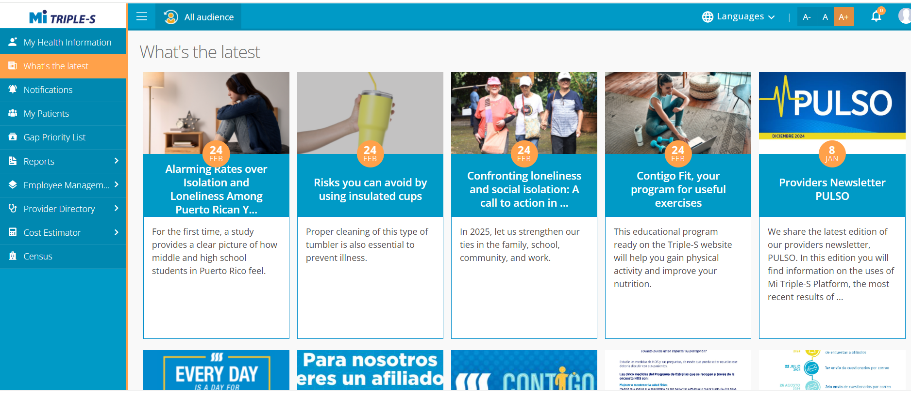
MOC Element 3: Provider Network – Cont.
Triple-S provides Model of Care training to its providers and Medical Groups through:
Continuing Medical Education
Pulso Magazine
Regular Mail
Mi Triple-S​ Portal: mitriples.com​
Email
Initial Orientation
as Provider
​

Slide 27
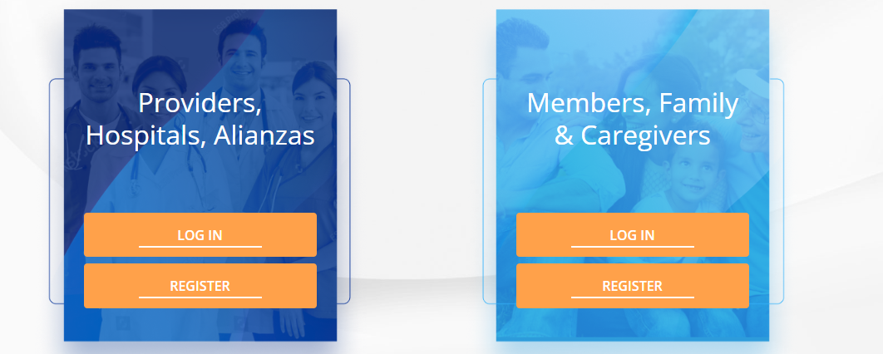
Access through the Provider Portal in Mi Triple-S
www.mitriples.com

Slide 28
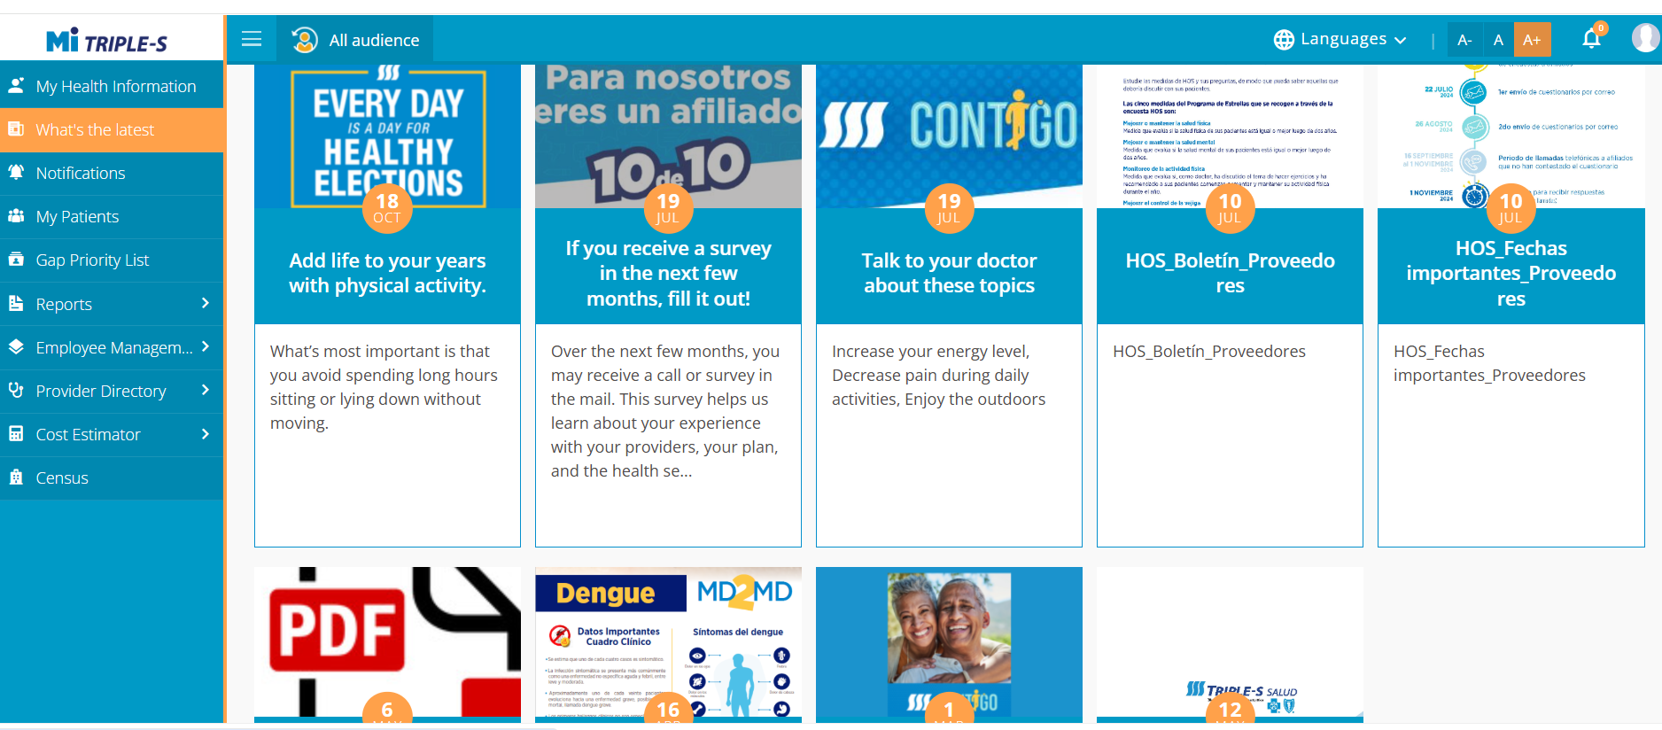
Where to find:
What’s the latest

Slide 29
MOC Element 4: Quality Measurement and Performance Improvement
Element A: MOC Quality Performance Improvement Plan
Element B: Measurable Goals and Health Outcomes for the MOC
Element C: Measuring Patient Experience of Care
Element D: Ongoing Performance Improvement Evaluation of the MOC
Element E: Dissemination of SNP Quality Performance Related to the MOC

Slide 30
MOC Element 4: Quality Measurement and Performance Improvement (Cont.)
Through this element, the performance of measures, results and indicators that impact the SNP population are monitored. The goal of this item is to improve the ability to provide health care services and benefits to SNP members, in a high-quality manner. The achievement of this goal demonstrates greater organizational effectiveness and efficiency through the incorporation of quality measurement and performance improvement concepts.
At Triple-S we have a comprehensive quality improvement program to measure the current level of performance and determine if organizational systems and processes need to be modified based on performance results.
We evaluate:
Star Program Measures
Quality Indicators of Members Interventions
Member Satisfaction - Regulatory Surveys: CAHPS & HOS
Appeals and Grievances - submitted directly to the plan or through Medicare

Slide 31
Measures
MOC Element 4: Quality Measurement and Performance Improvement
Star Program HEDIS Measures
Measures | Measures (cont.)
Breast Cancer Screening | Controlling High Blood Pressure
Colorectal Cancer Screening | Medication Reconciliation Post-Discharge
Care for Older Adults – Medication Review | Transitions of Care
Care for Older Adults – Pain Assessment | Statin Therapy for Patients with Cardiovascular Disease
Osteoporosis Management in Women who had a Fracture | Plan All-Cause Readmissions
Diabetes Care – Eye Exam | Follow-up after Emergency Department Visit for People with Multiple High-Risk Chronic Conditions
Diabetes Care – Blood Sugar Controlled

Slide 32
How do the elements of the Model of Care work with each other?
The Population Care Model at Triple-S Advantage is the basis for promoting quality services to the population with special needs, through the identification, description, and coordination of care performed by an interdisciplinary team and a network of healthcare providers contracted to provide excellent service.
Our approach is to emphasize the importance of continuously monitoring the health status of our members to manage their health needs and improve their quality of life.
MOC 1 Description of SNP Population
MOC 2 Care Coordination
MOC 3 Provider Network
MOC 4
Quality Measurement and Performance Improvement
You, as a Triple-S Provider, are an essential part of the Care Model to achieve an integrated and holistic management of our members.

Slide 33
Contact
If you have any questions, please contact us at:​
​
EBOComplianceMatters@centene.com
PROV_2025_28_E

