Slide 1
Combating Medicare Parts C&D Fraud Waste & Abuse

Slide 2
2

Slide 3
slide3

Slide 4
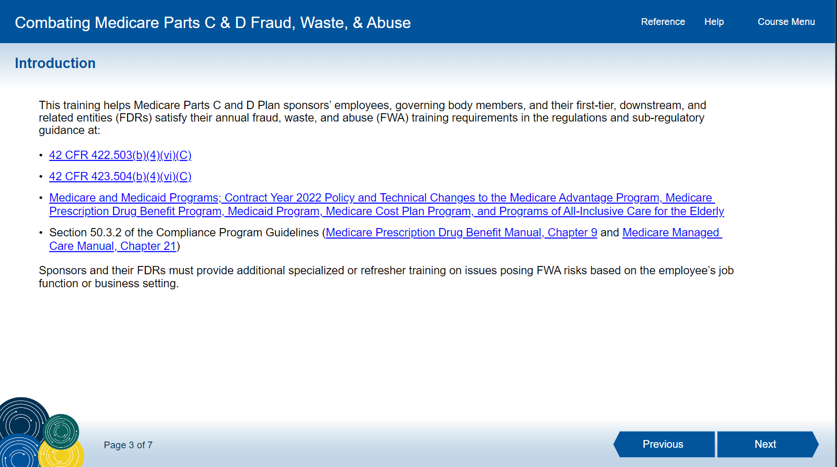
4

Slide 5
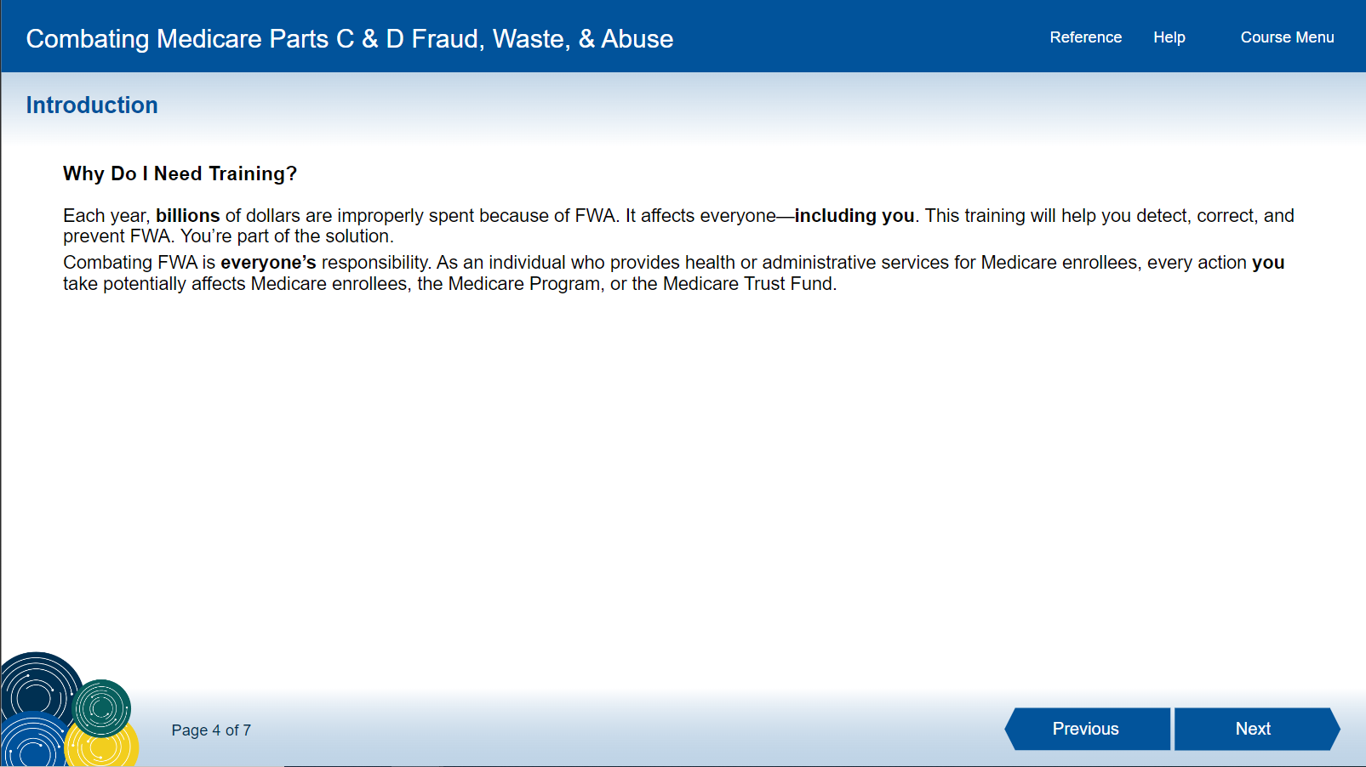
5

Slide 6
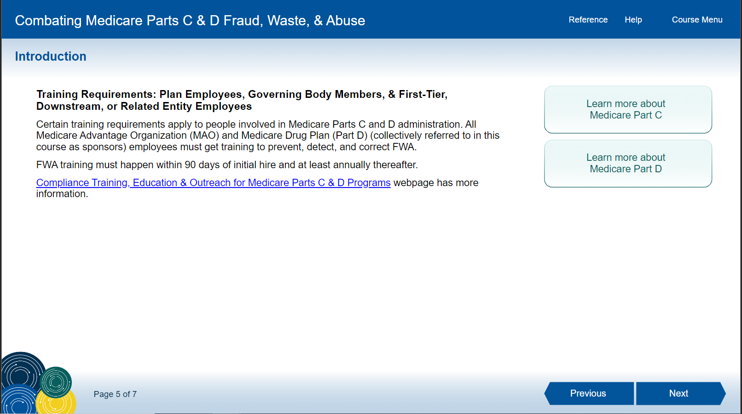
6

Slide 7
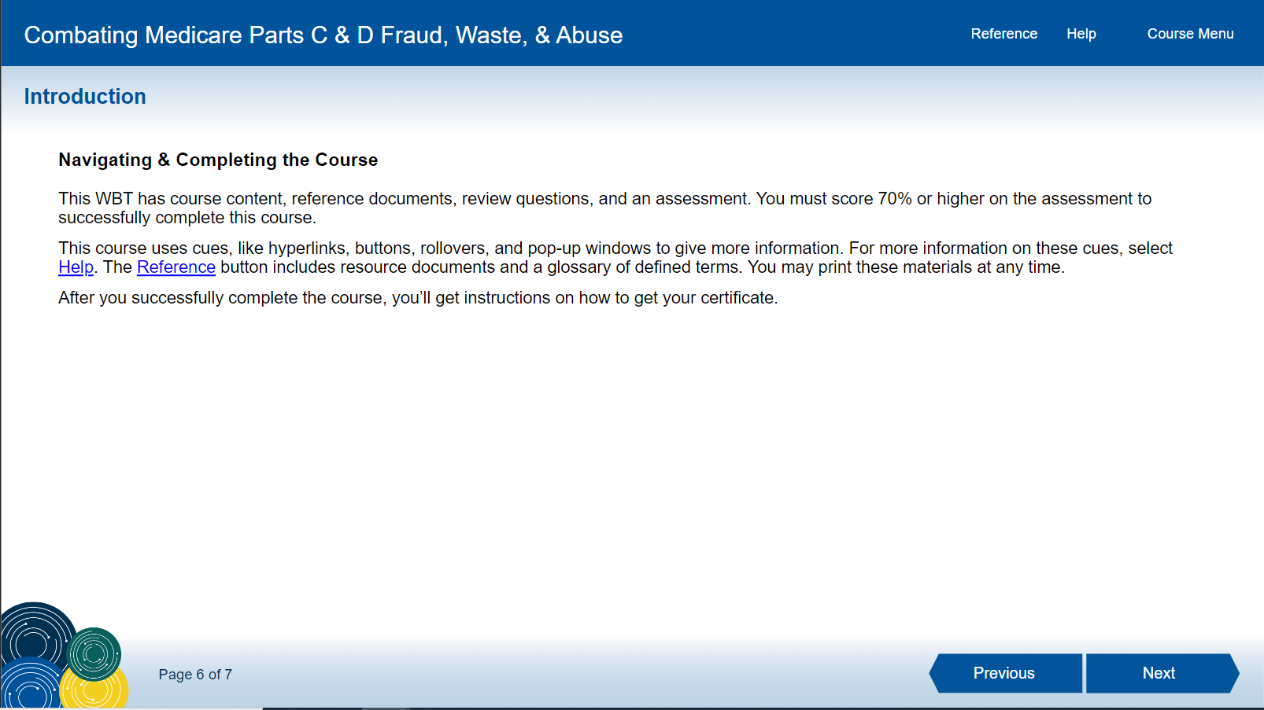
7

Slide 8
8

Slide 9
9

Slide 10
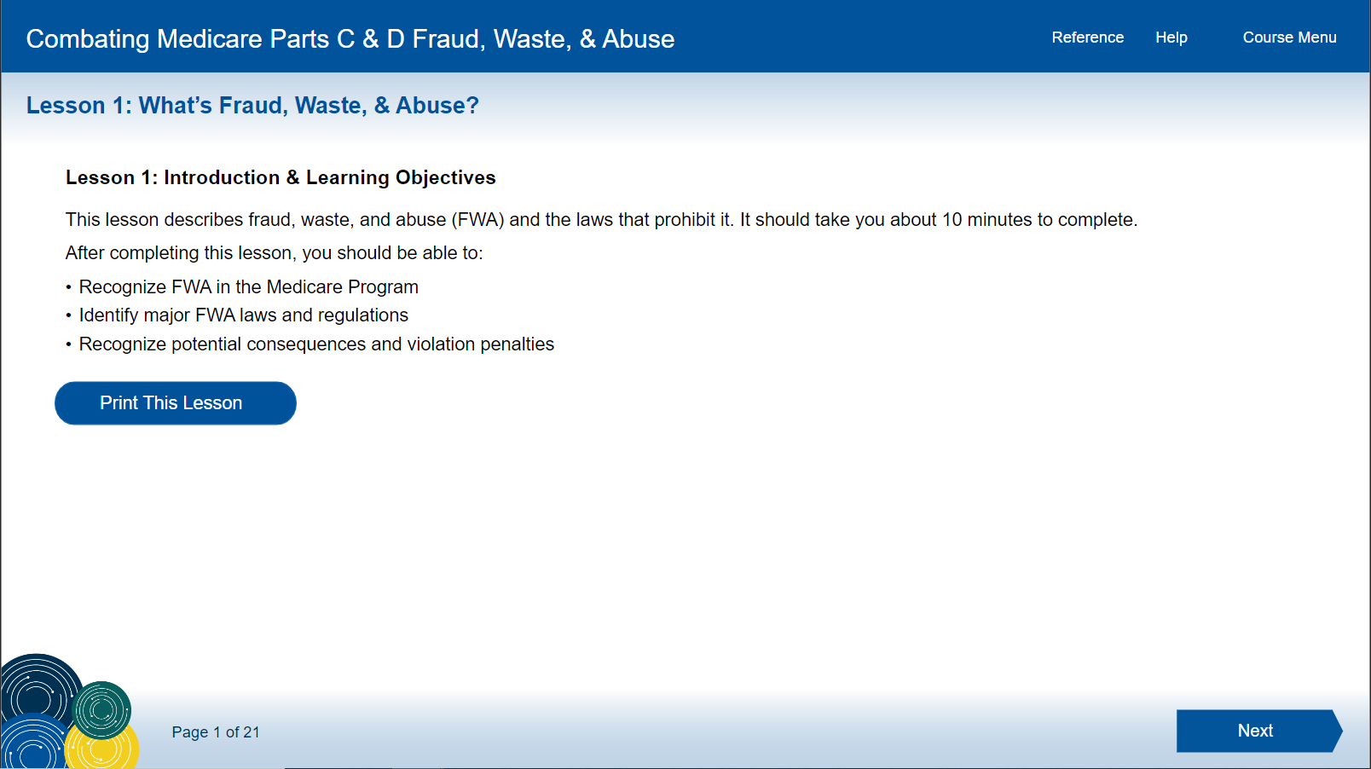
10

Slide 11
11

Slide 12
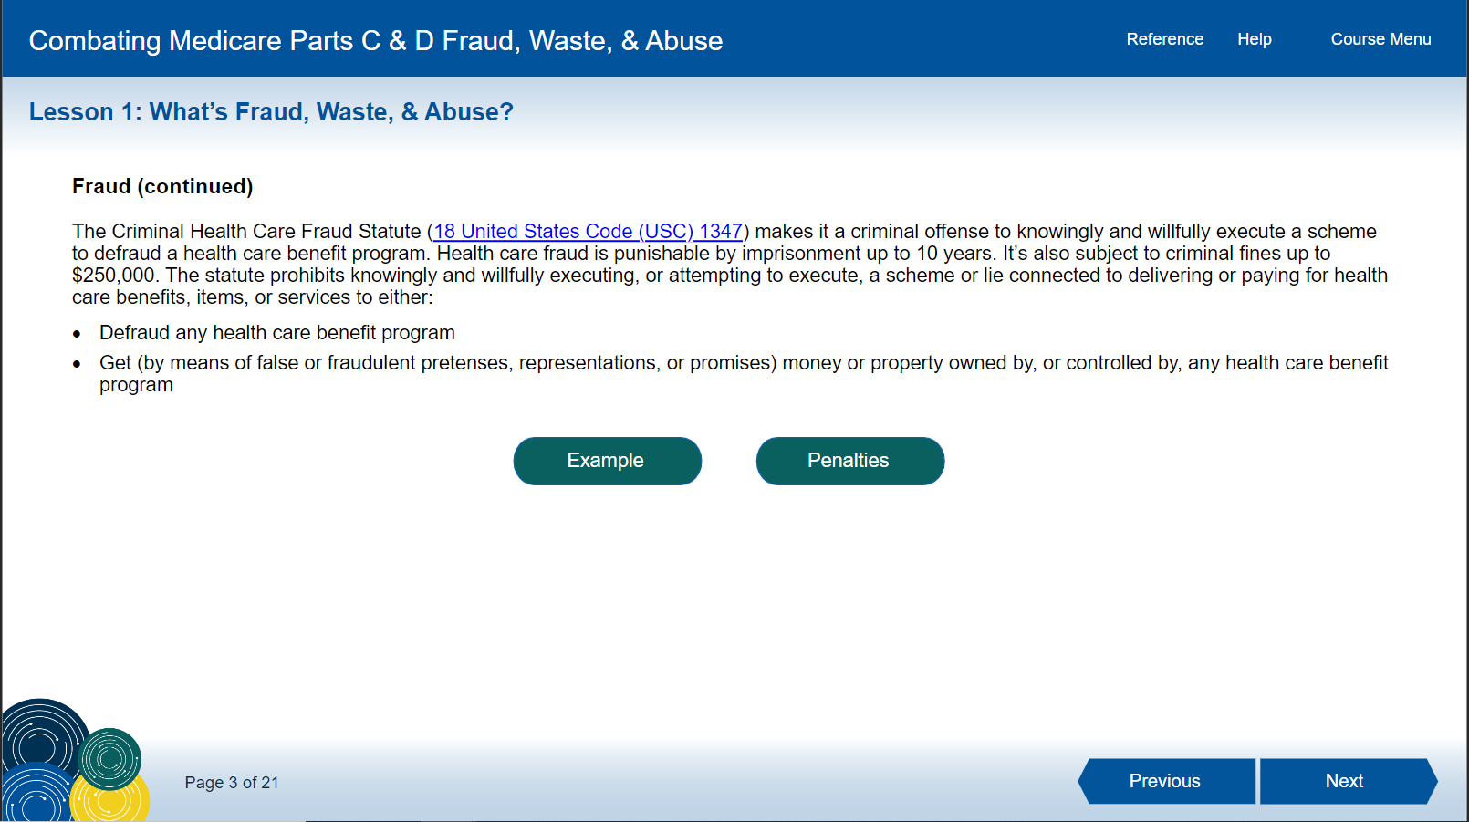
12

Slide 13
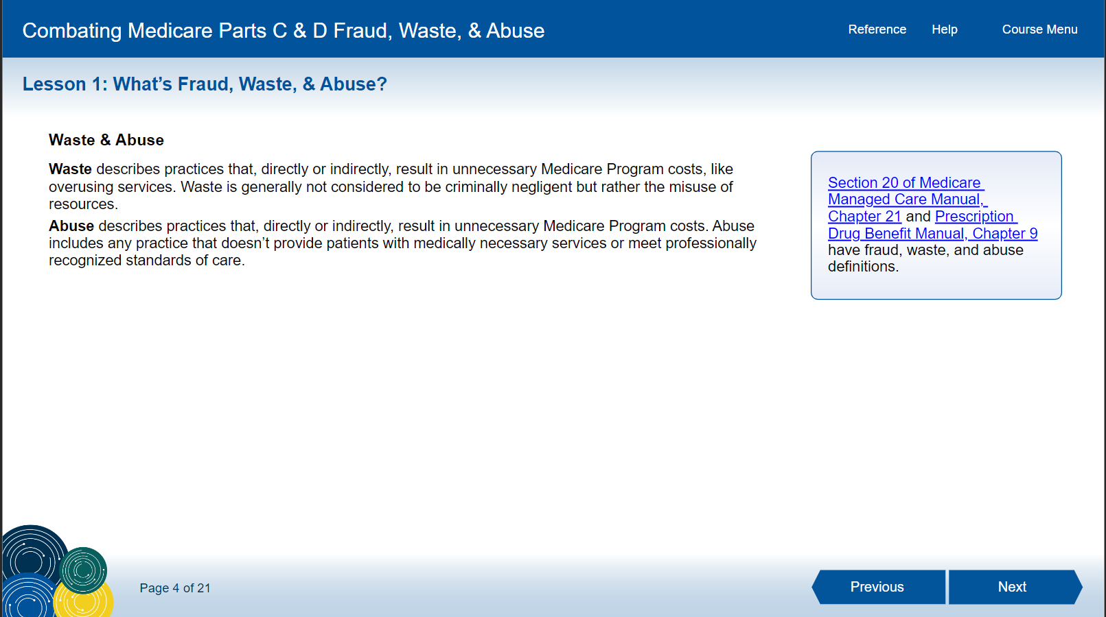
13

Slide 14
14

Slide 15
15

Slide 16
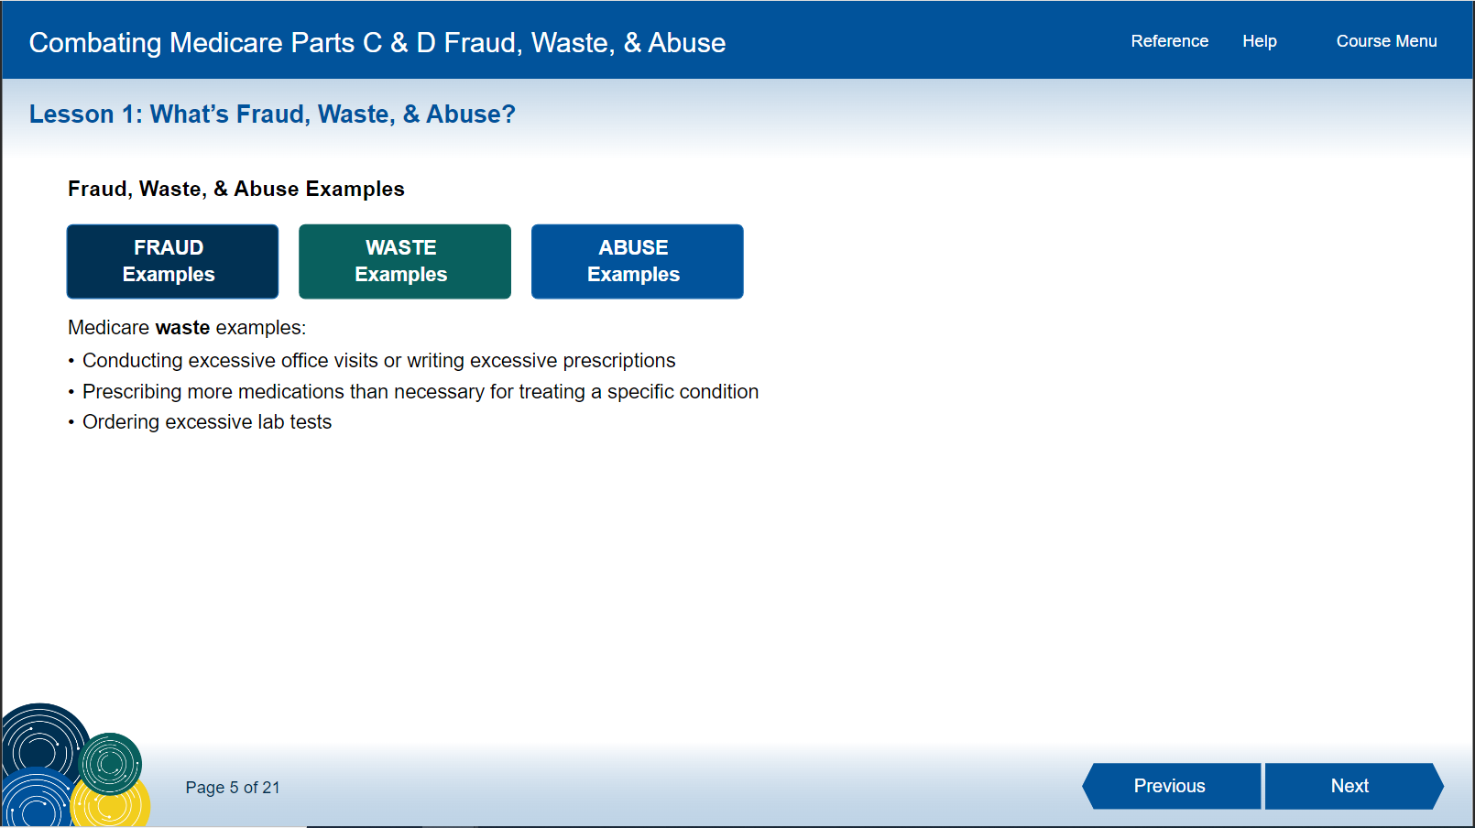
16

Slide 17
17

Slide 18
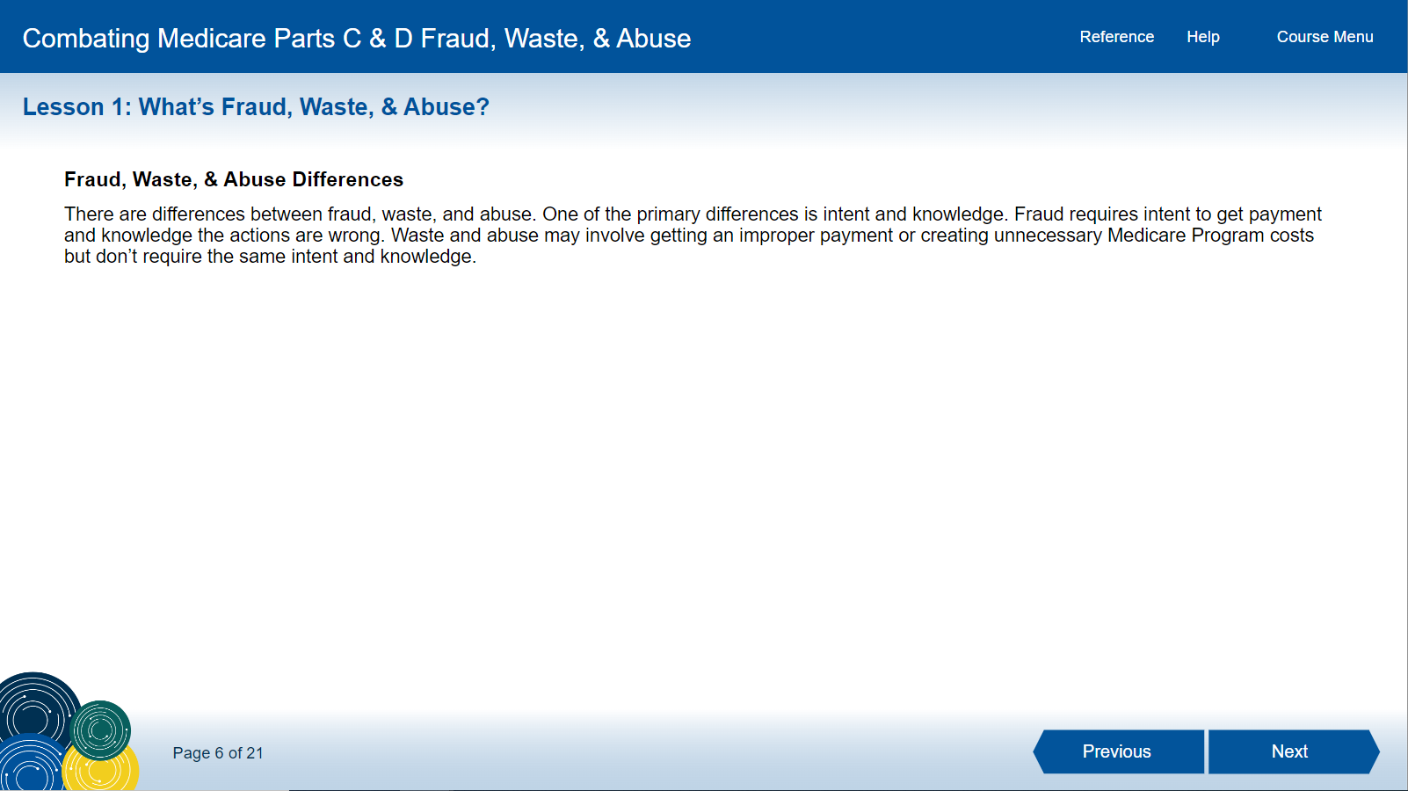
18

Slide 19
19

Slide 20
20

Slide 21
Examples

Slide 22
22

Slide 23
23

Slide 24
Examples

Slide 25
25

Slide 26
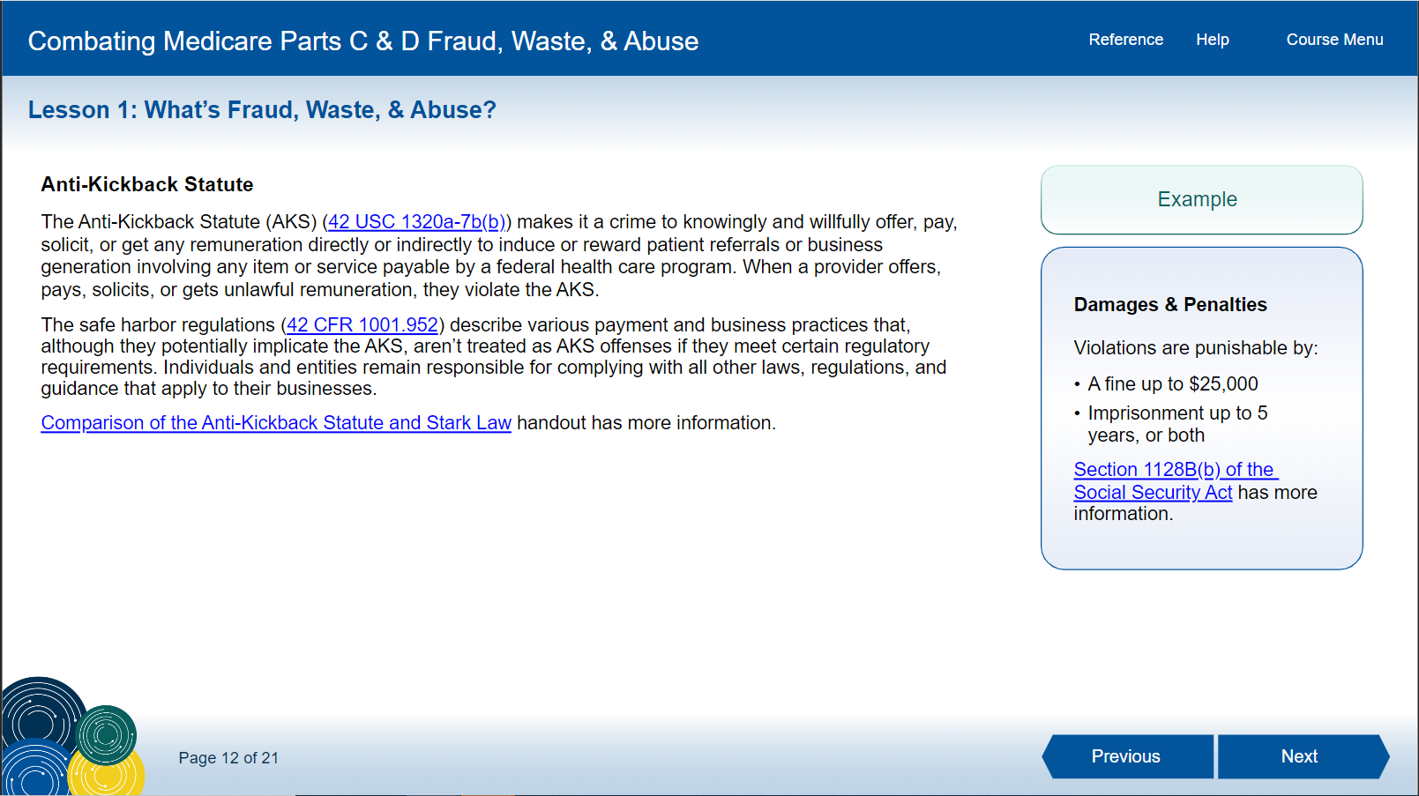
26

Slide 27
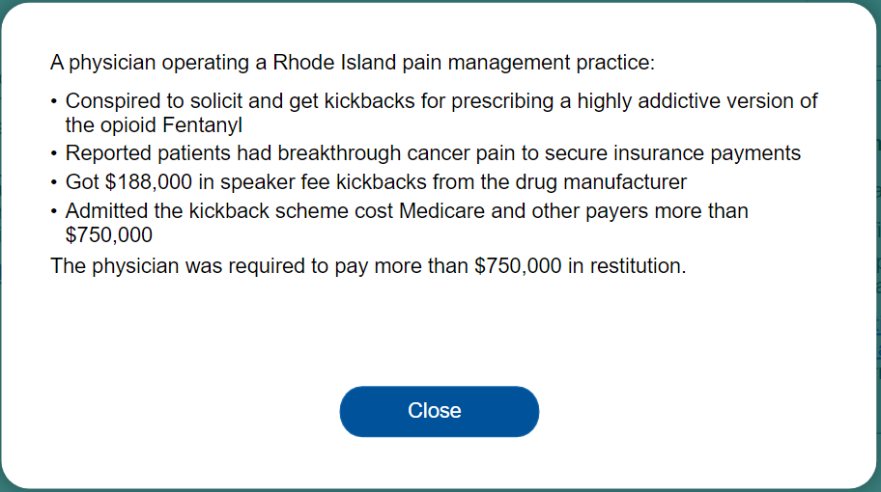
Examples

Slide 28
28

Slide 29
Example

Slide 30
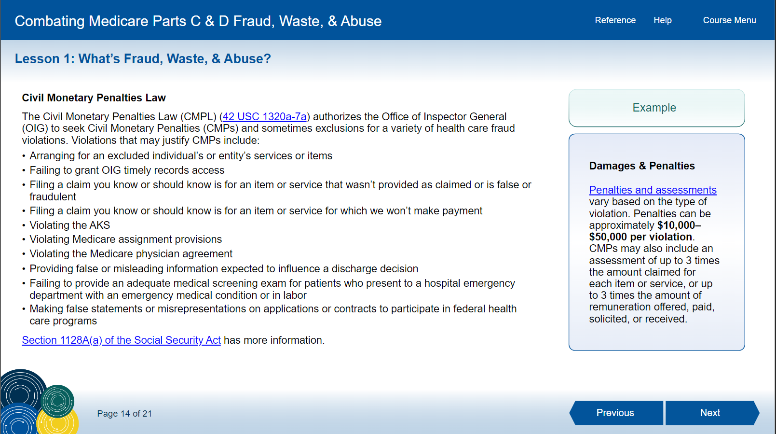
30

Slide 31
Example

Slide 32
32

Slide 33
Example

Slide 34
34

Slide 35
Example

Slide 36
36

Slide 37
37

Slide 38
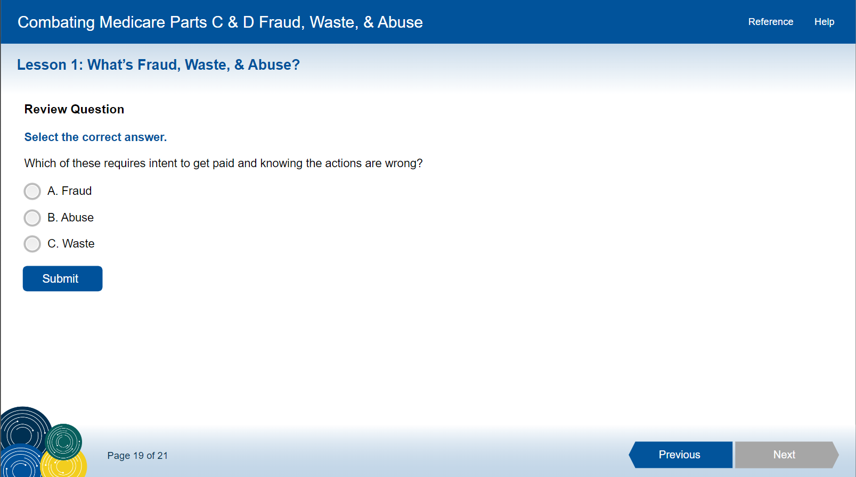
38

Slide 39
The Correct Answer Is…
A

Slide 40
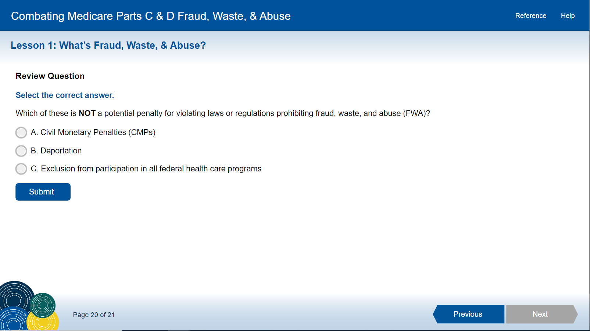
40

Slide 41
The Correct Answer Is…
B

Slide 42
42

Slide 43
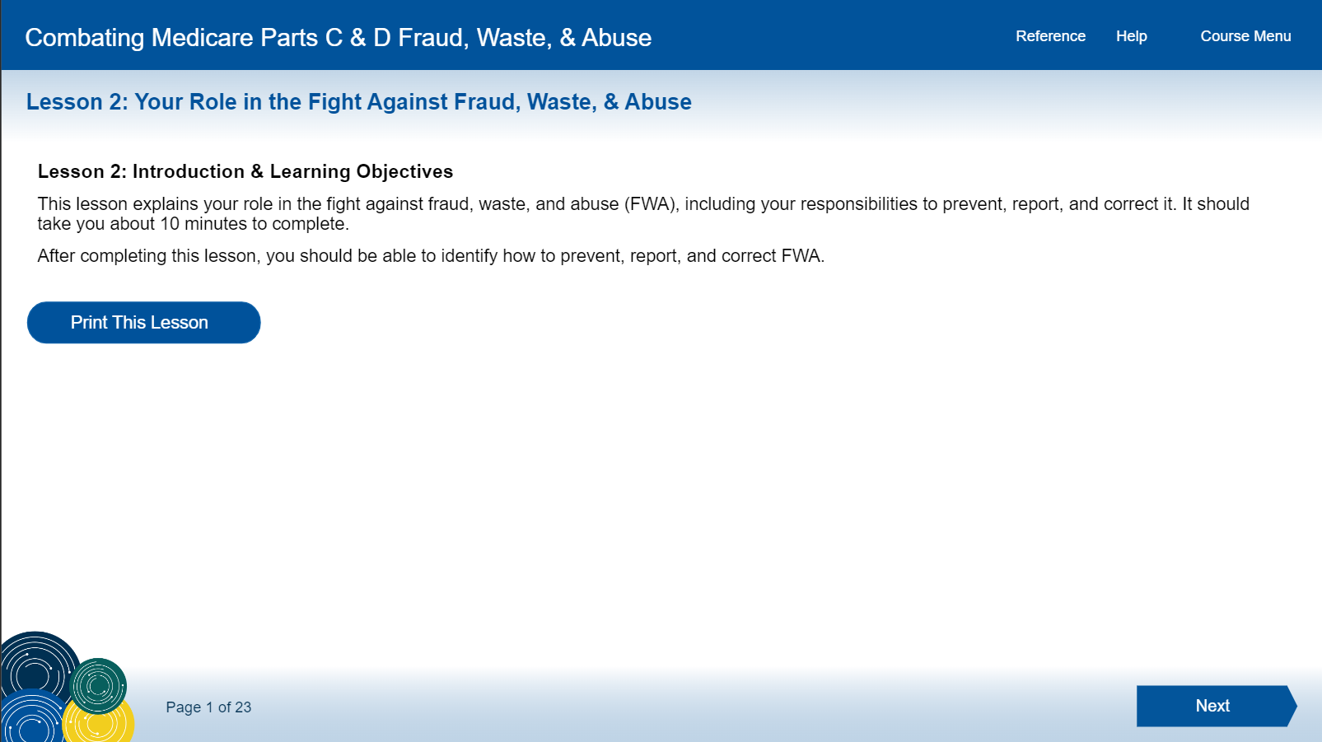
43

Slide 44
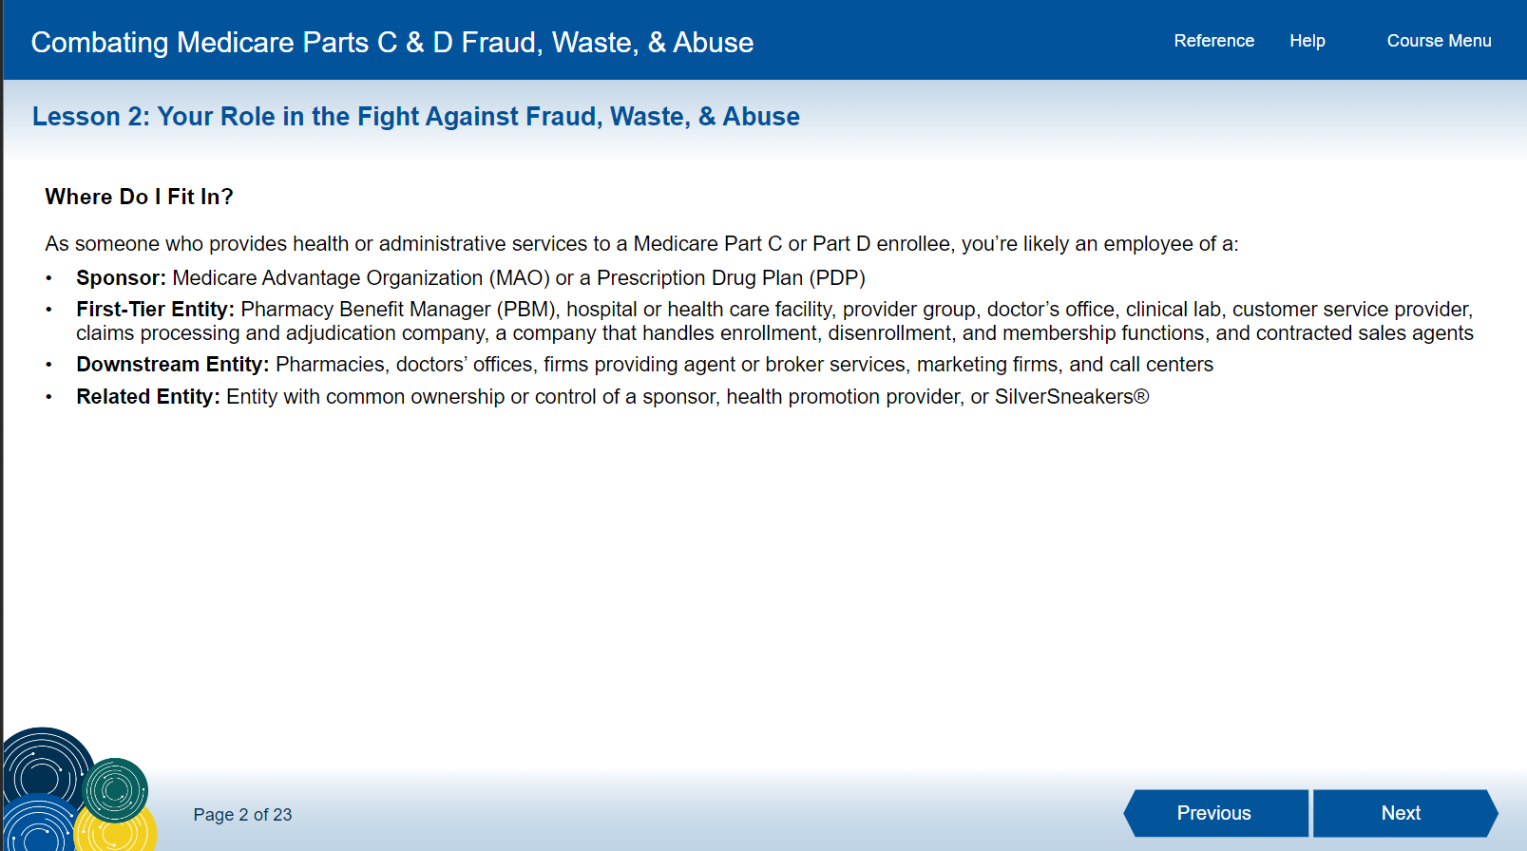
44

Slide 45
45

Slide 46
46

Slide 47
47

Slide 48
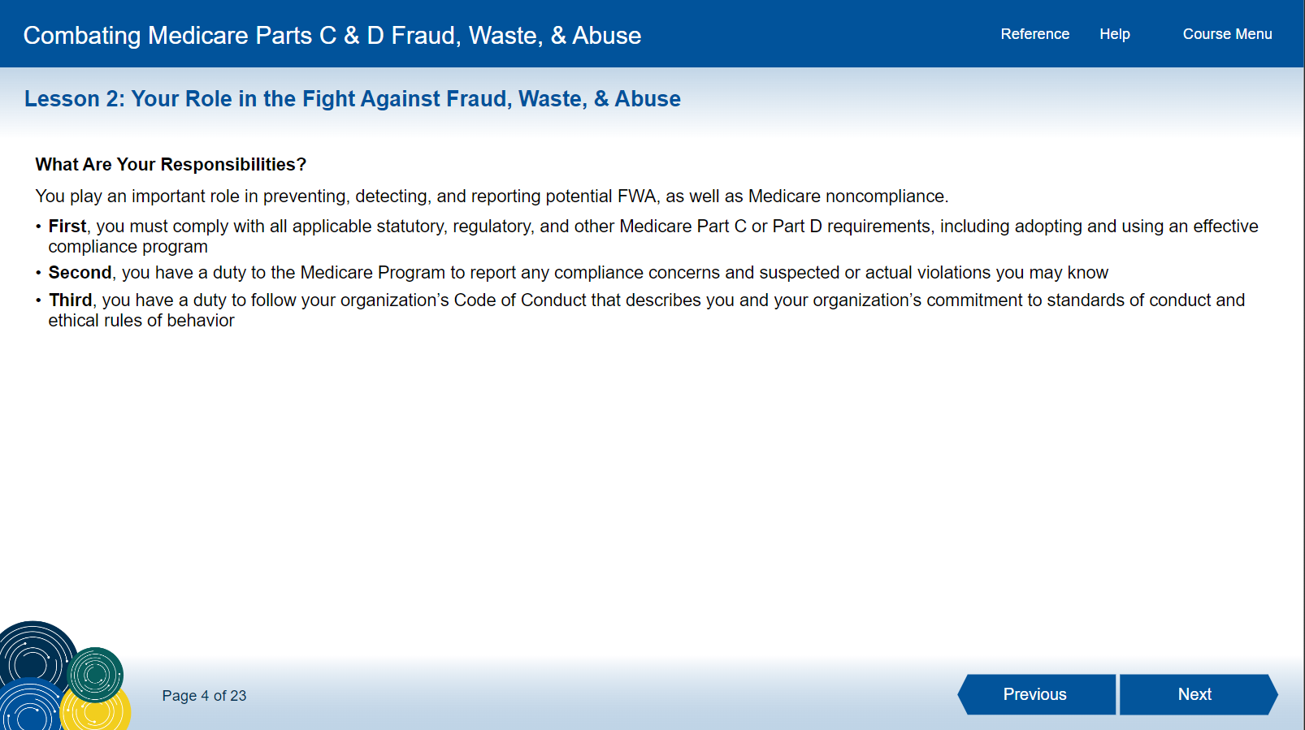
48

Slide 49
49

Slide 50
50

Slide 51
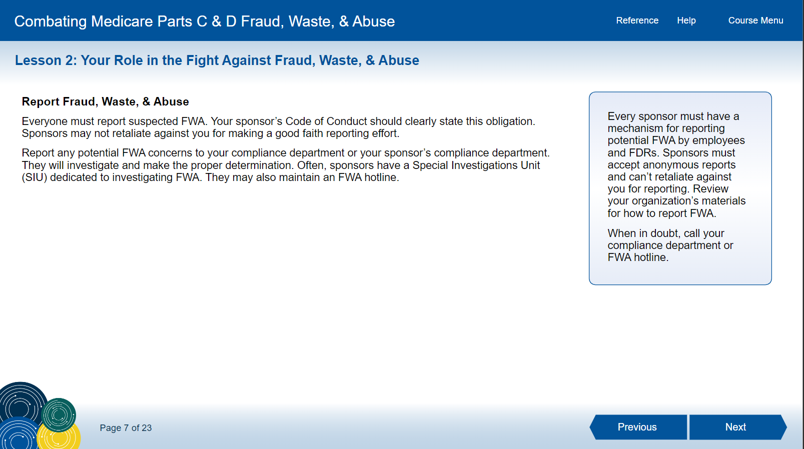
51

Slide 52
52

Slide 53
53

Slide 54
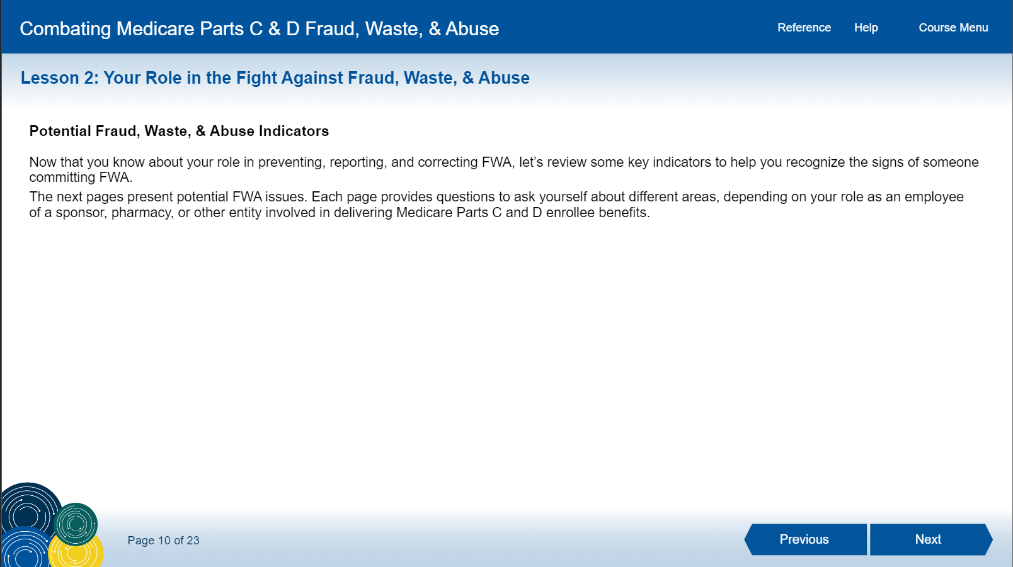
54

Slide 55
55

Slide 56
56

Slide 57
57

Slide 58
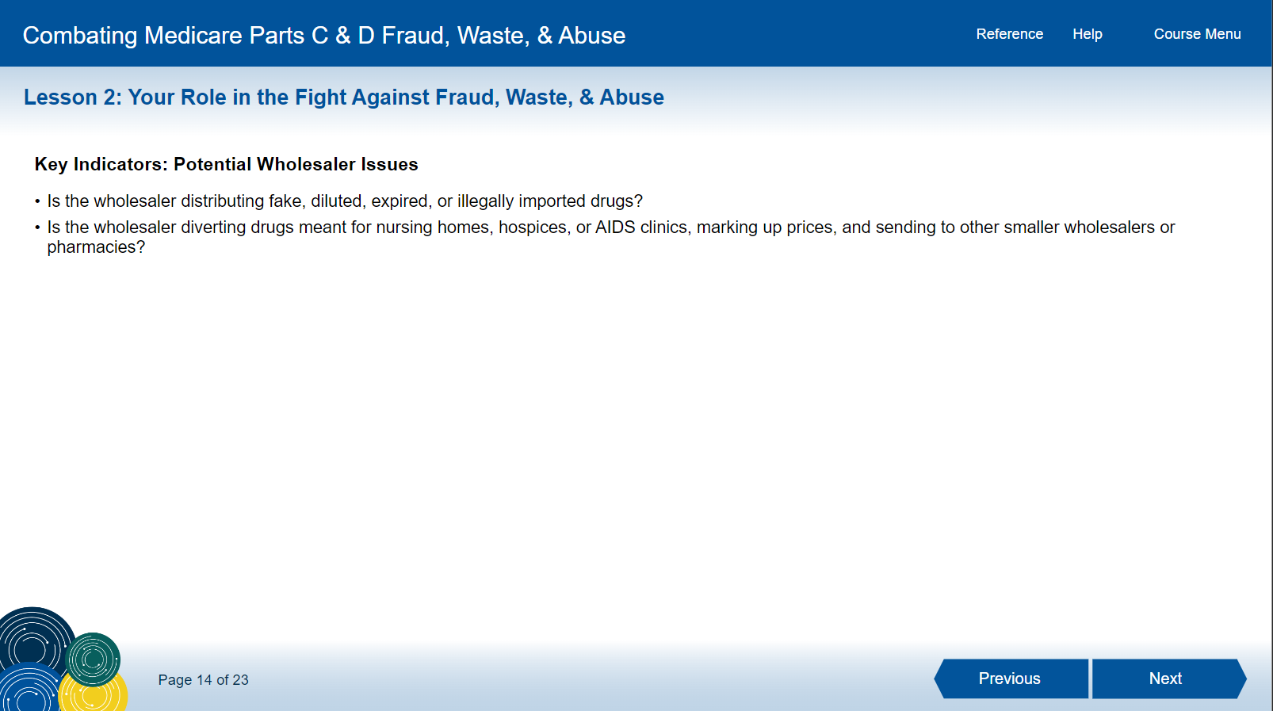
58

Slide 59
59

Slide 60
60

Slide 61
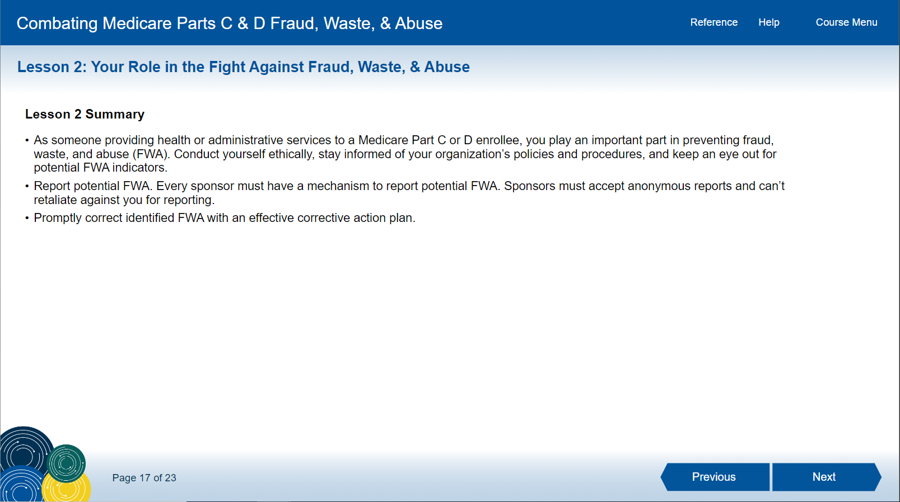
61

Slide 62
62

Slide 63
63

Slide 64
64

Slide 65
The Correct Answer Is…
C

Slide 66
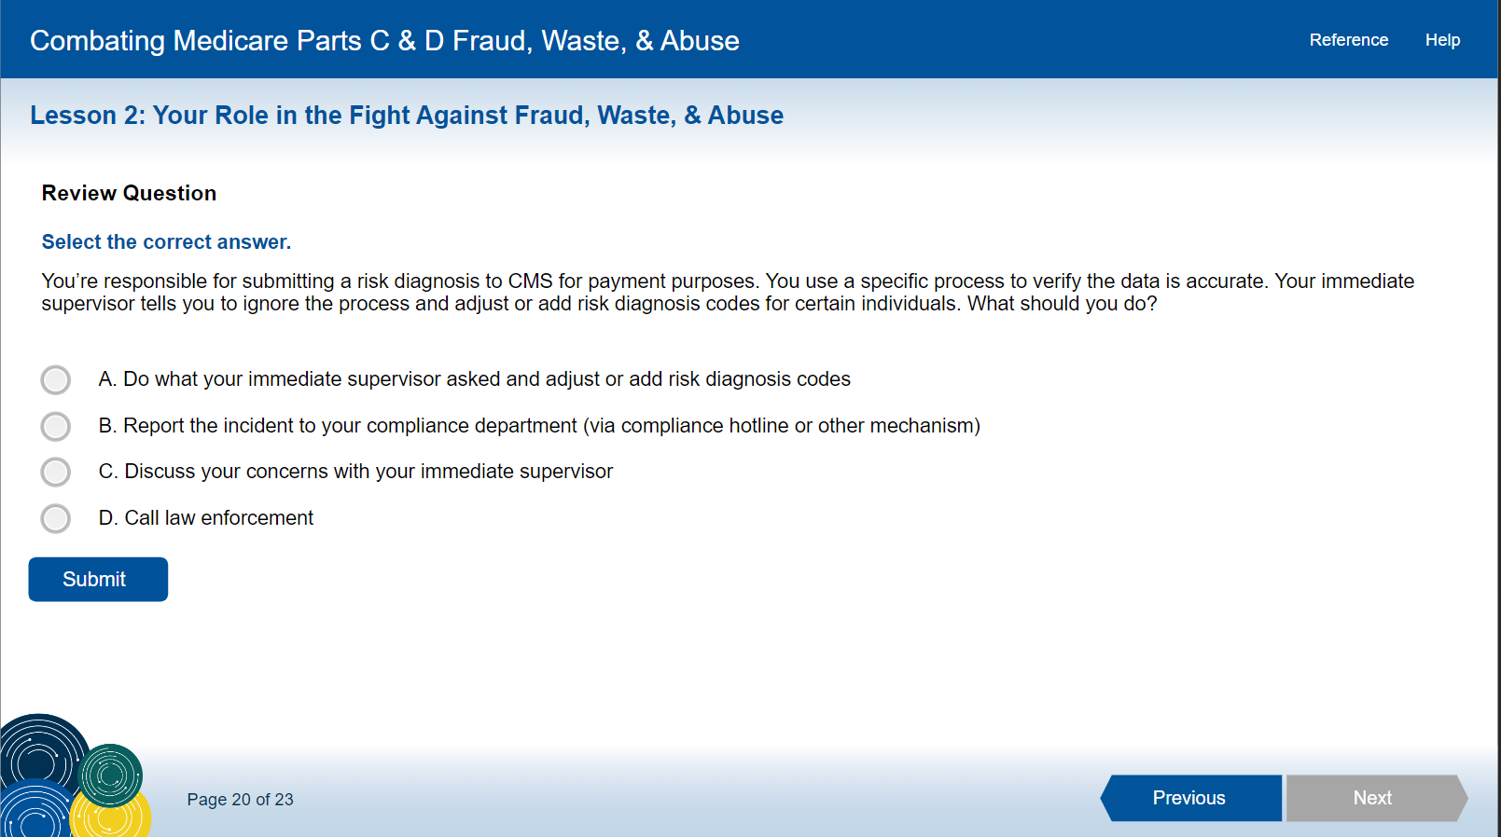
66

Slide 67
The Correct Answer Is…
B

Slide 68
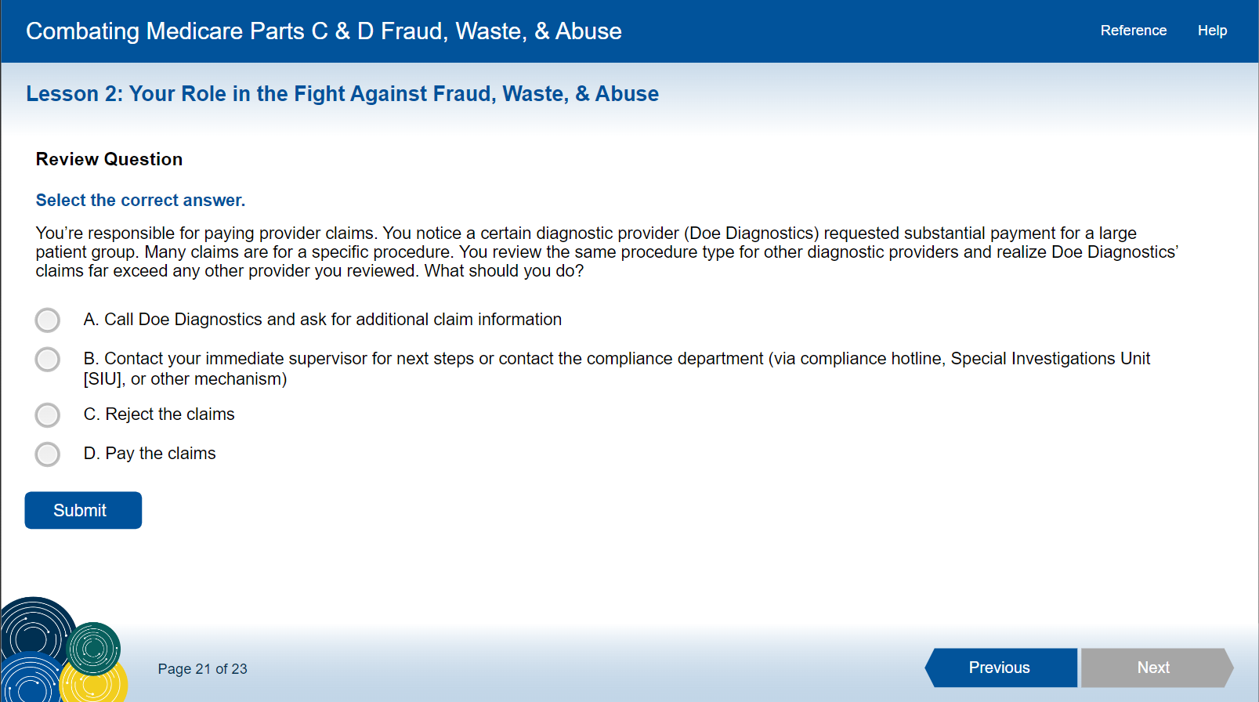
68

Slide 69
Answer
B

Slide 70
70

Slide 71
Answer
E

Slide 72
72

Slide 73
73

Slide 74
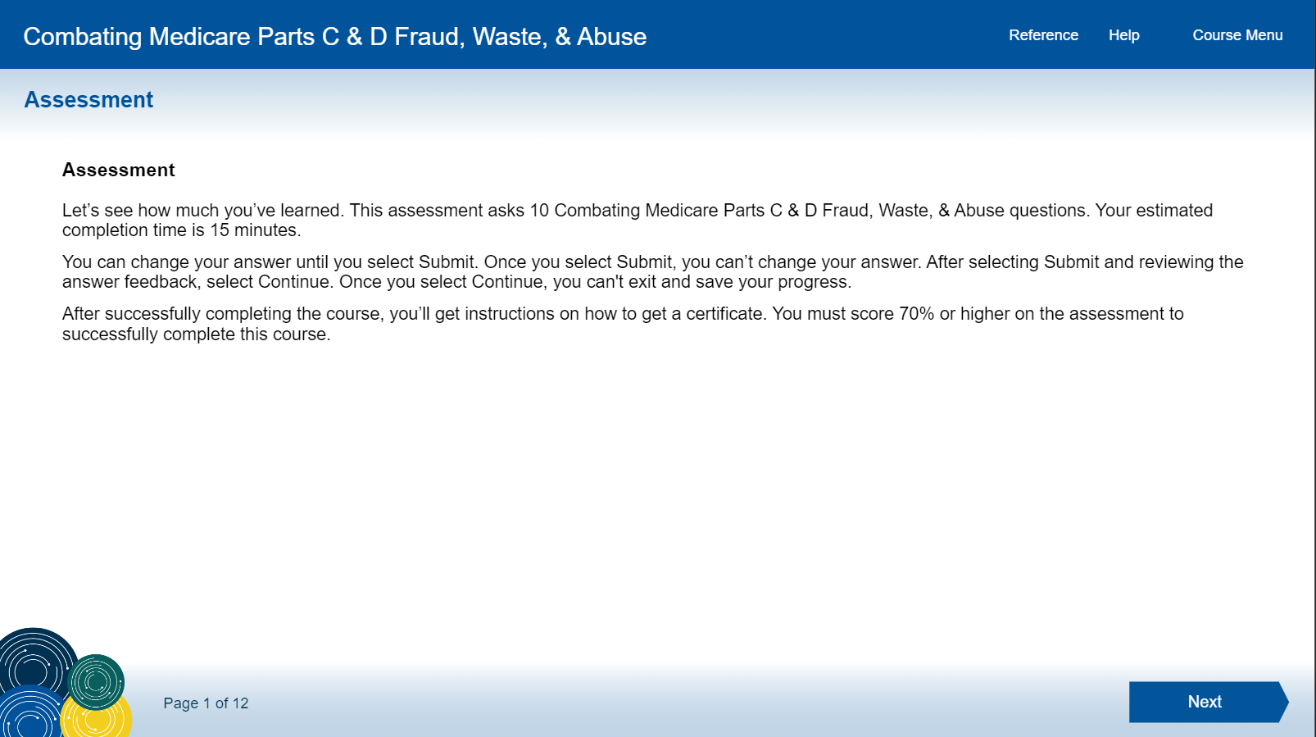
74

Slide 75
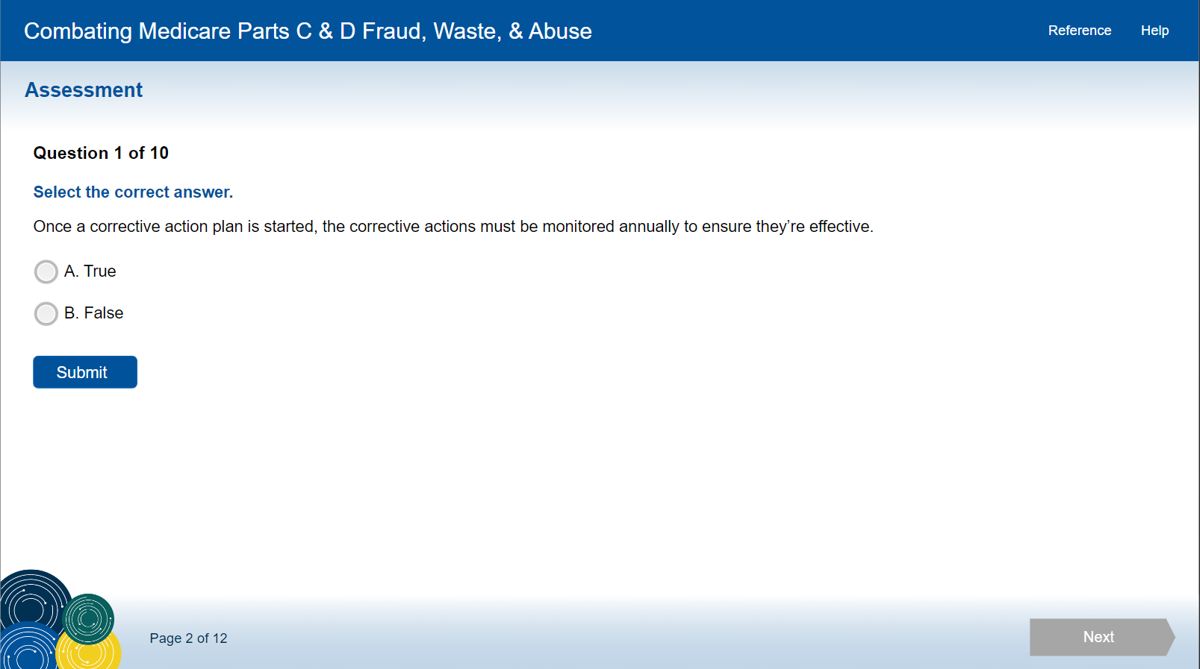
75

Slide 76
Answer
B

Slide 77
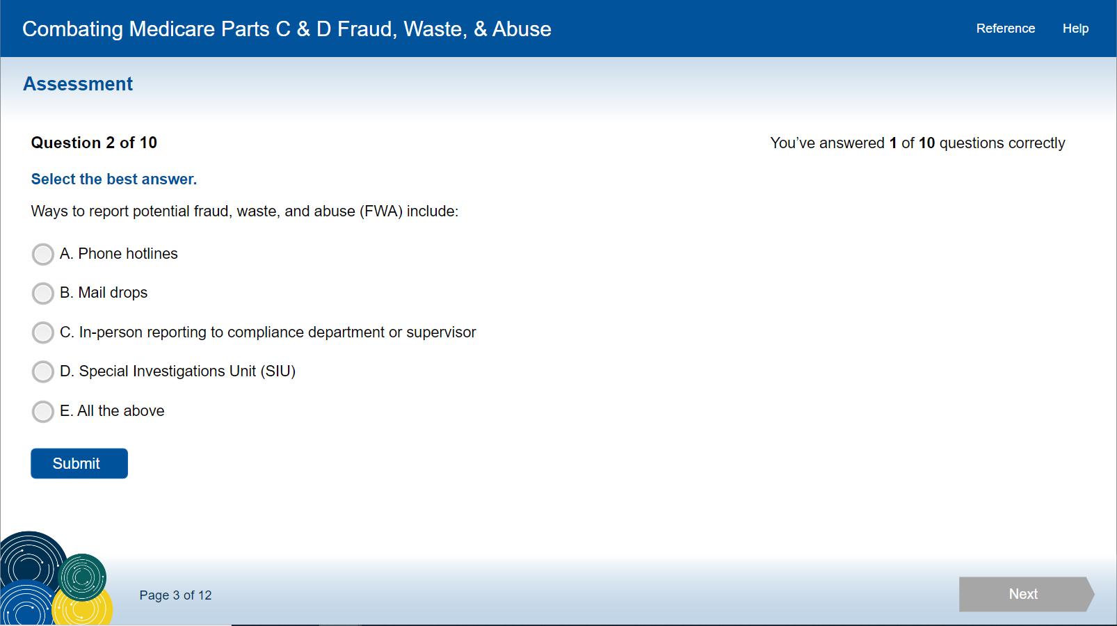
77

Slide 78
Answer
E

Slide 79
79

Slide 80
Answer
B

Slide 81
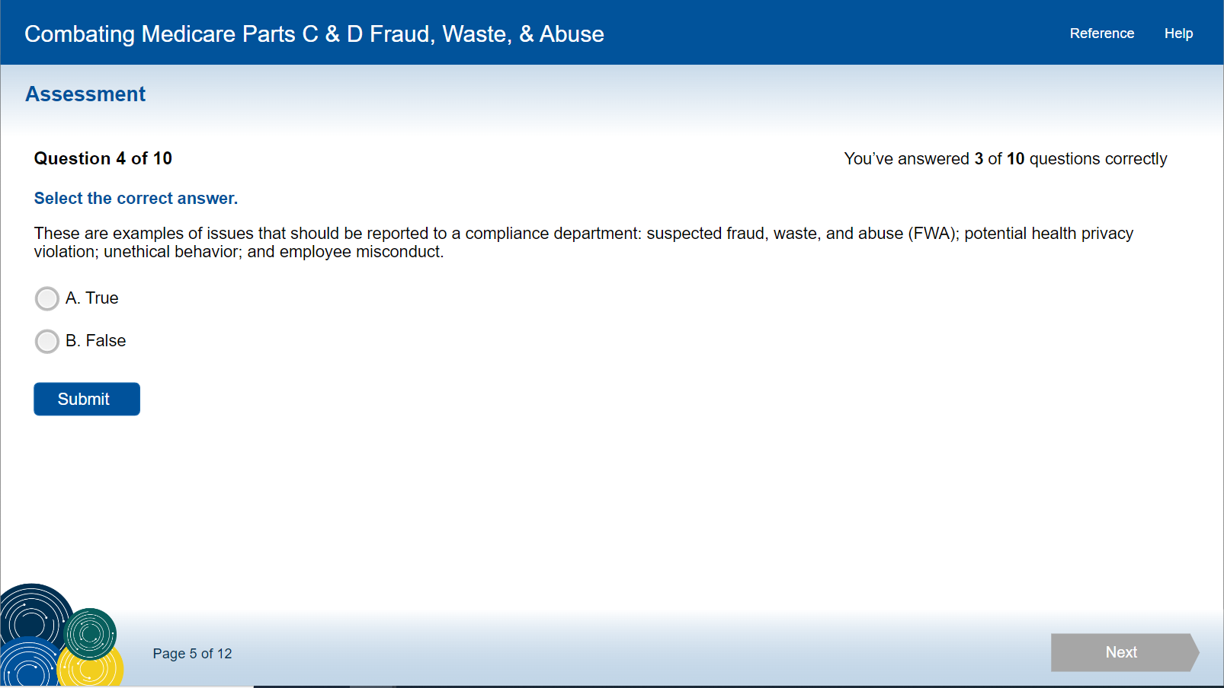
81

Slide 82
The Correct Answer Is…
A

Slide 83
83

Slide 84
Answer
A

Slide 85
85

Slide 86
Answer
A

Slide 87
87

Slide 88
Answer
A

Slide 89
89

Slide 90
Answer
A

Slide 91
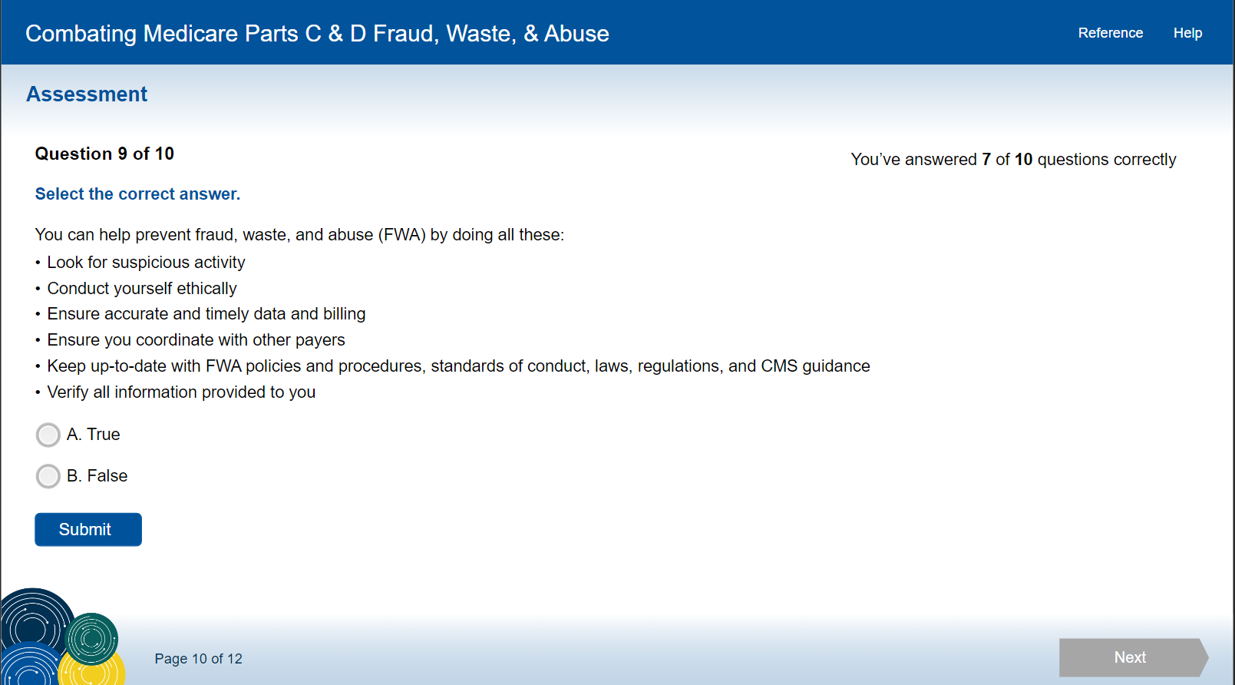
91

Slide 92
Answer
A

Slide 93
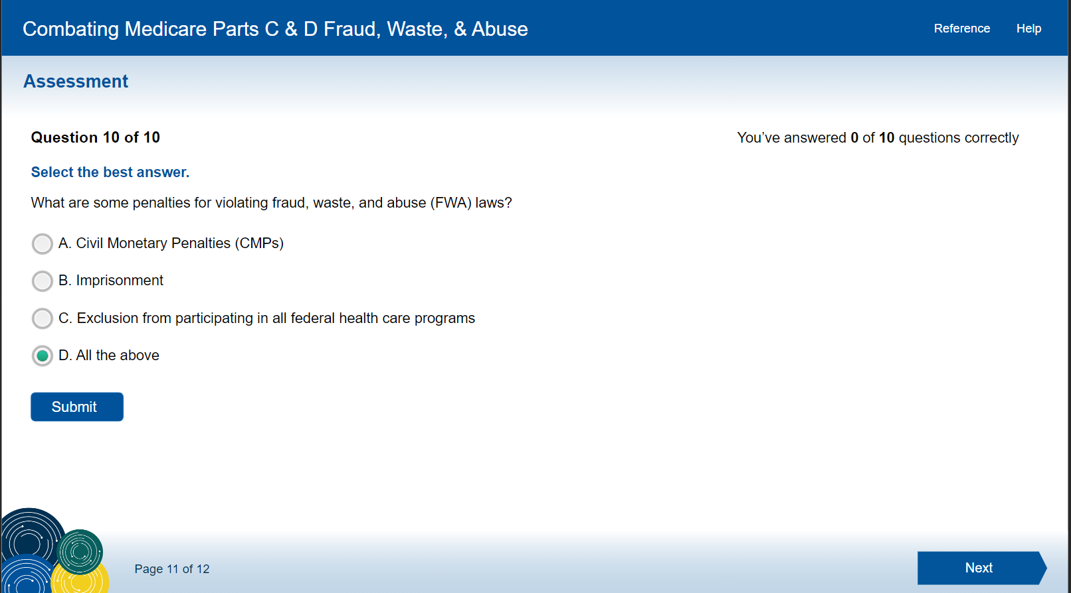
Answer
A

Slide 94
Answer
D

